Slide 1


Unit 5: Lesson 16 It’s written in the stars

Slide 2


Slide 3
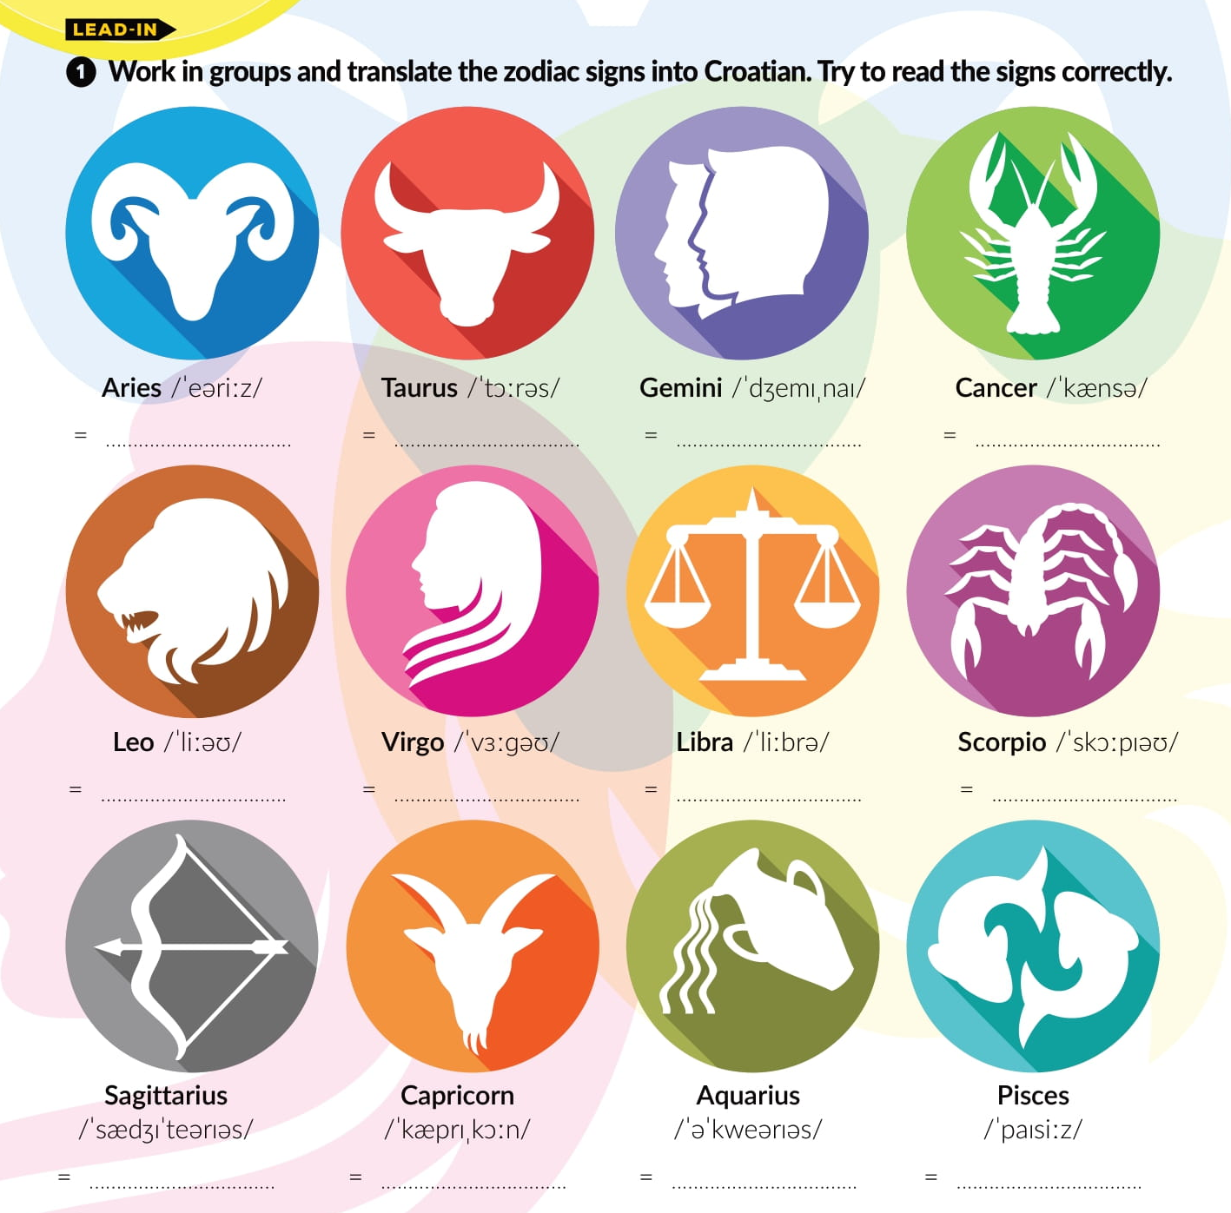

Slide 4


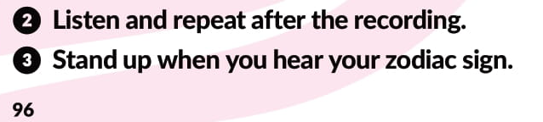
https://www.e-sfera.hr/dodatni-digitalni-sadrzaji/28dc0f2f-5b0f-4688-a4e1-f96e5227ba1d/assets/audio/34__lesson_16___it_s_written_in_the_stars.mp3

Slide 5
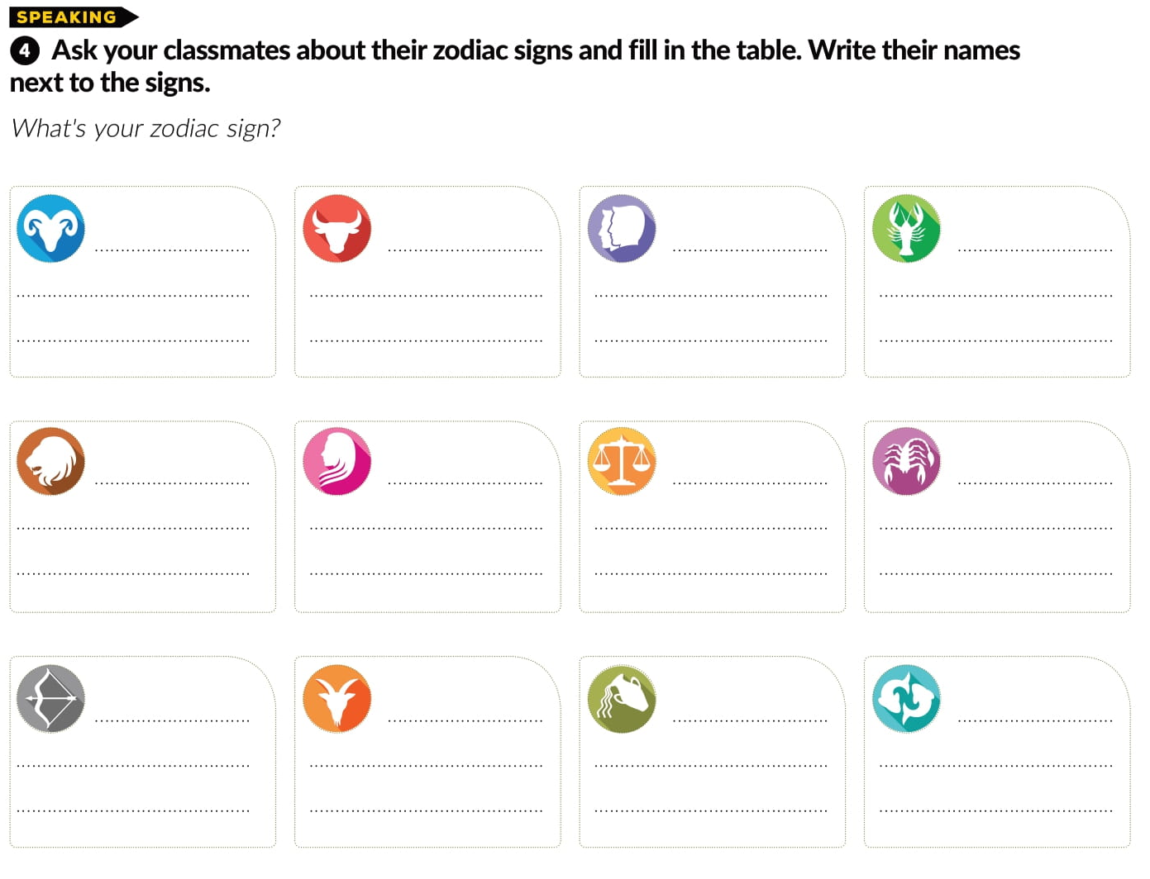

Slide 6
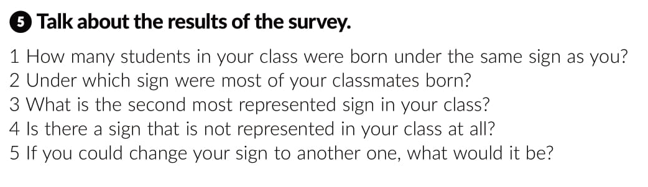

Slide 7
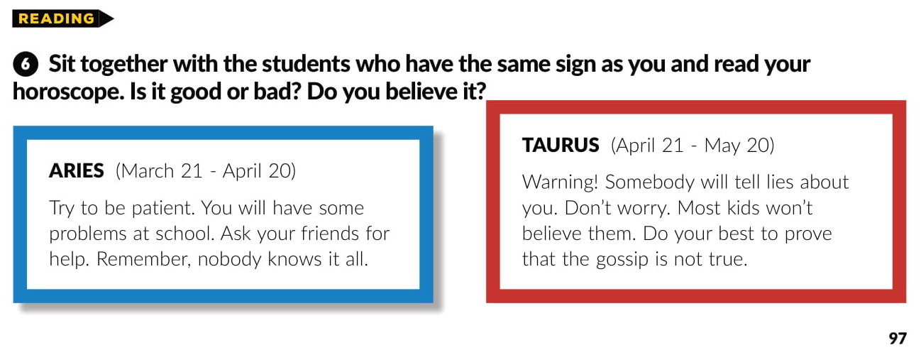
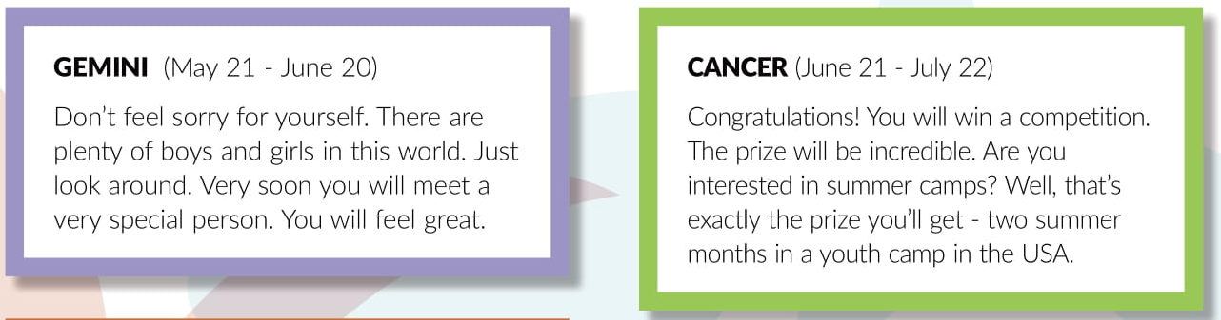
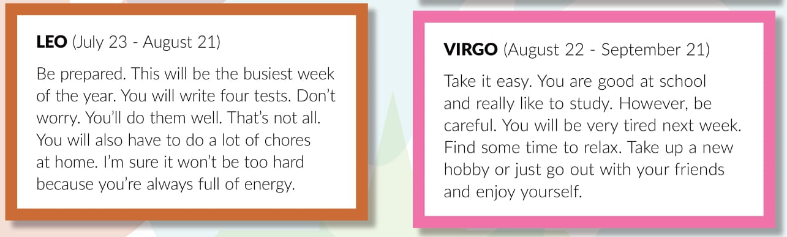

Slide 8
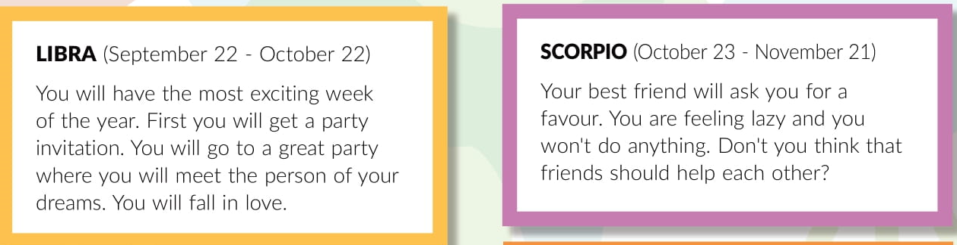
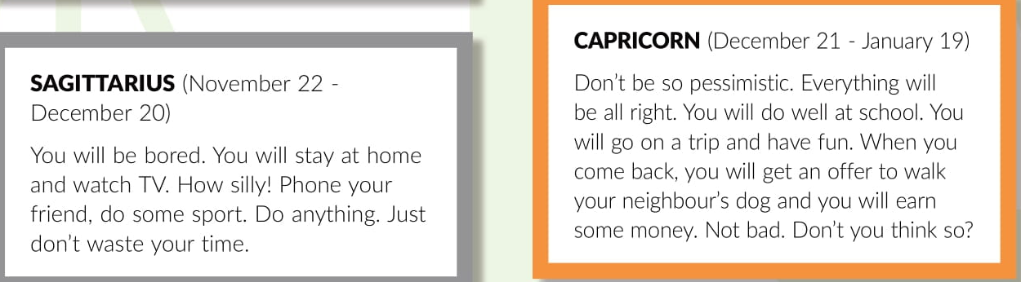
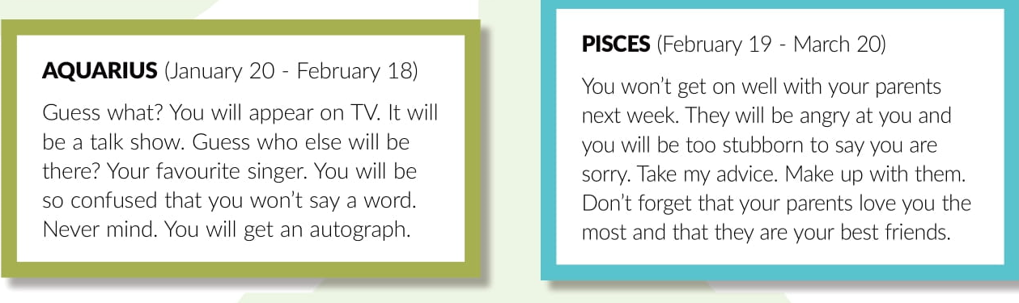

Slide 9
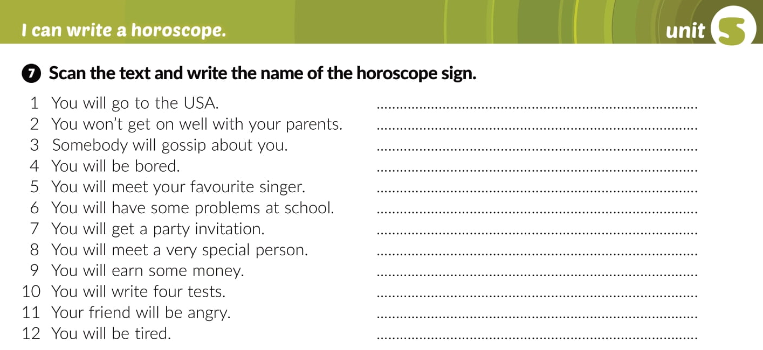
Cancer
Pisces
Taurus
Sagittarius
Aquarius
Aries
Libra
Gemini
Capricorn
Leo
Scorpio
Virgo

Slide 10
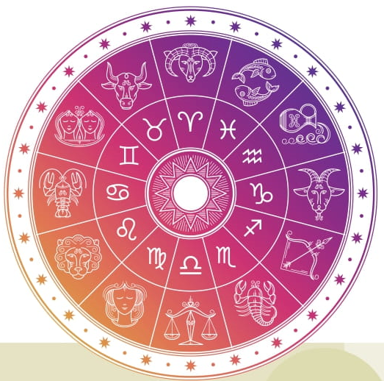
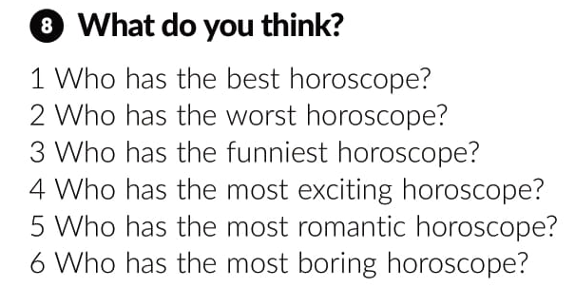

Slide 11

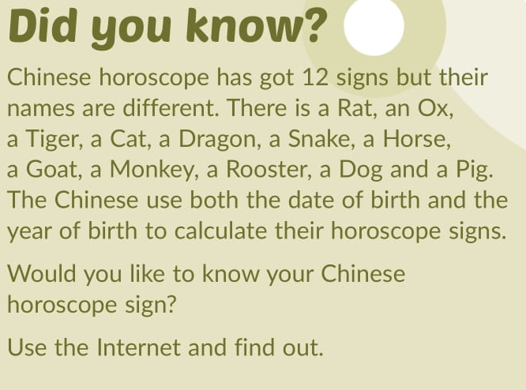

Slide 12

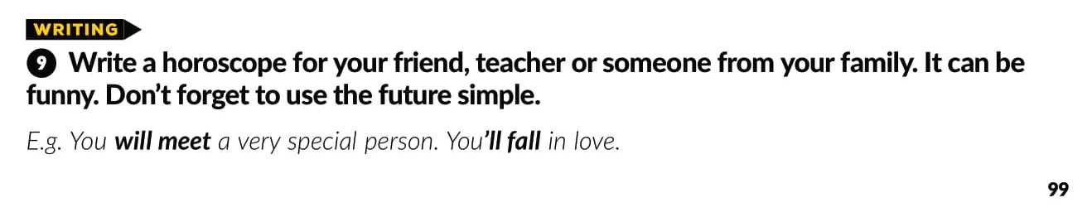

Slide 13

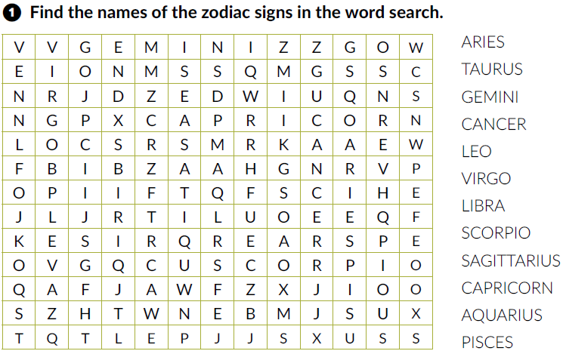
Workbook, p. 96

Slide 14
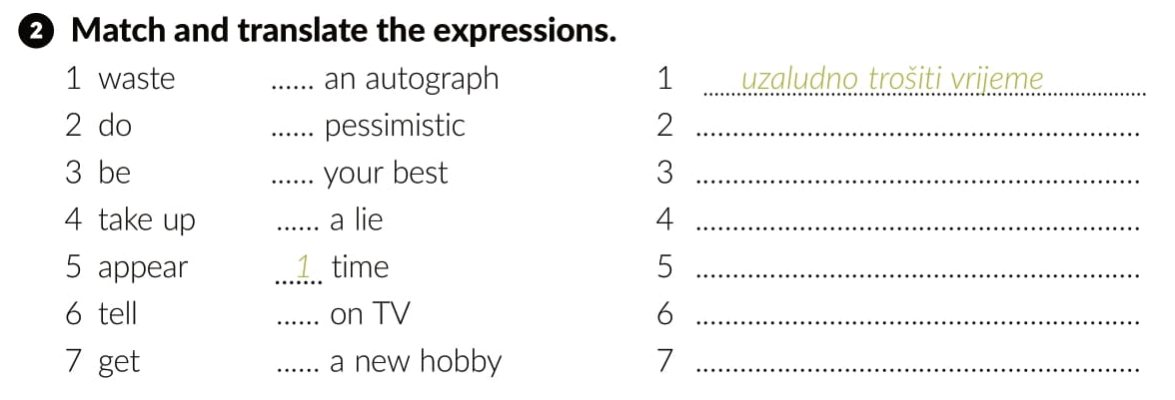
7
3
dati sve od sebe
2
biti pesimističan
6
pronaći novi hobi
pojaviti se na televiziji
5
lagati
4
dobiti autogram

Slide 15
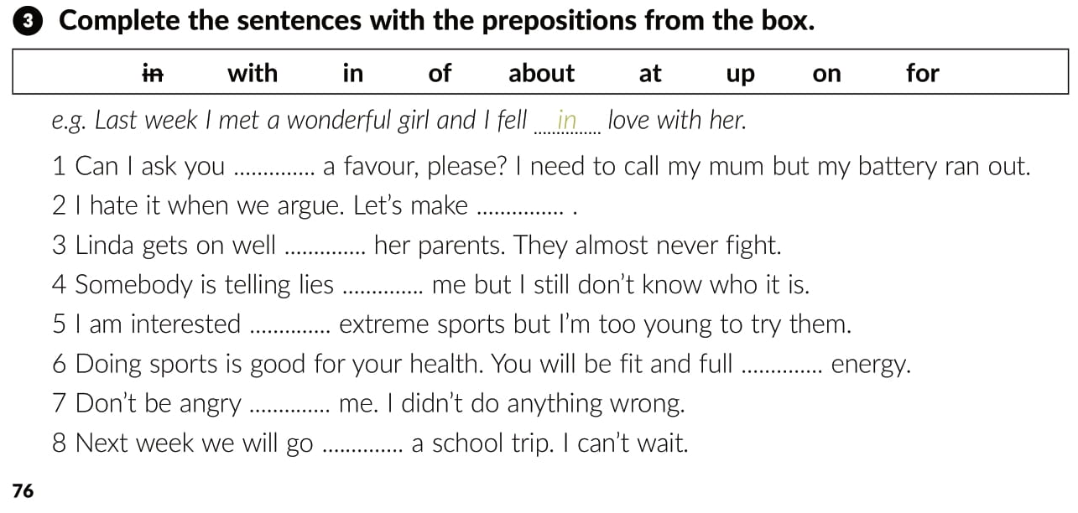
for
up
with
about
in
of
with
on

Slide 16
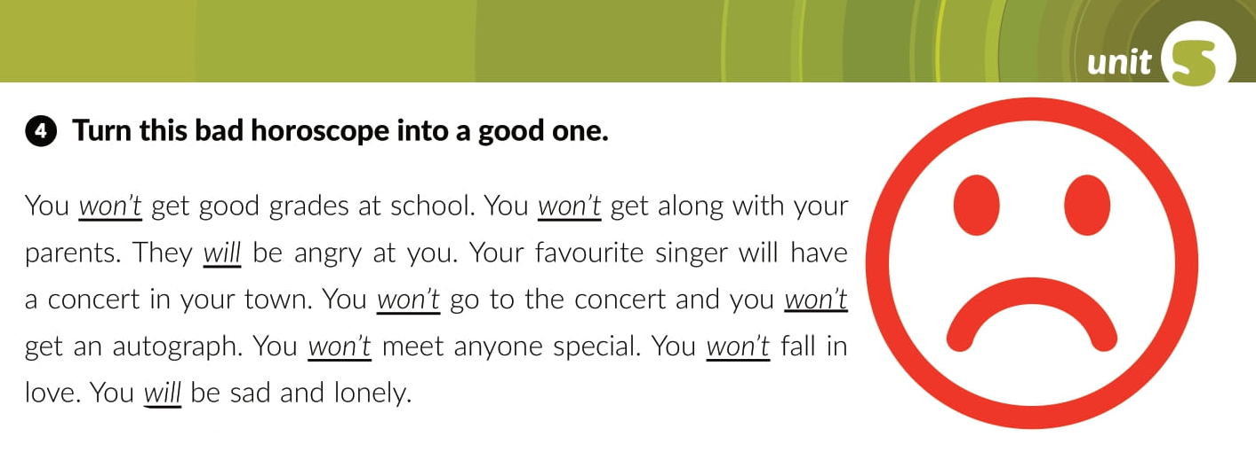
will
will
won’t
will
will
will
won’t

Slide 17

You will get along with your parents.
They won’t be angry with you.
You will go to the concert and you will get an autograph..
You will meet someone special.
You will fall in love
You won’t be sad and lonely

Slide 18
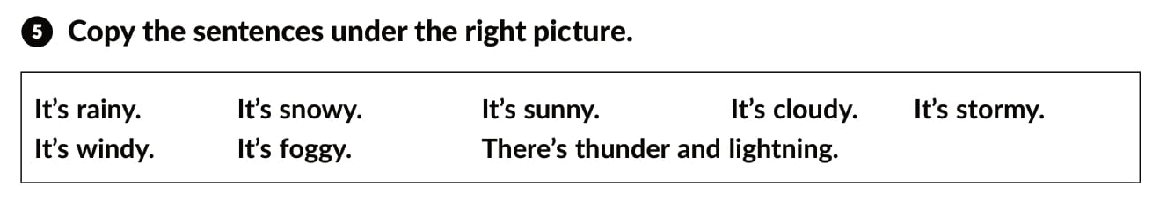
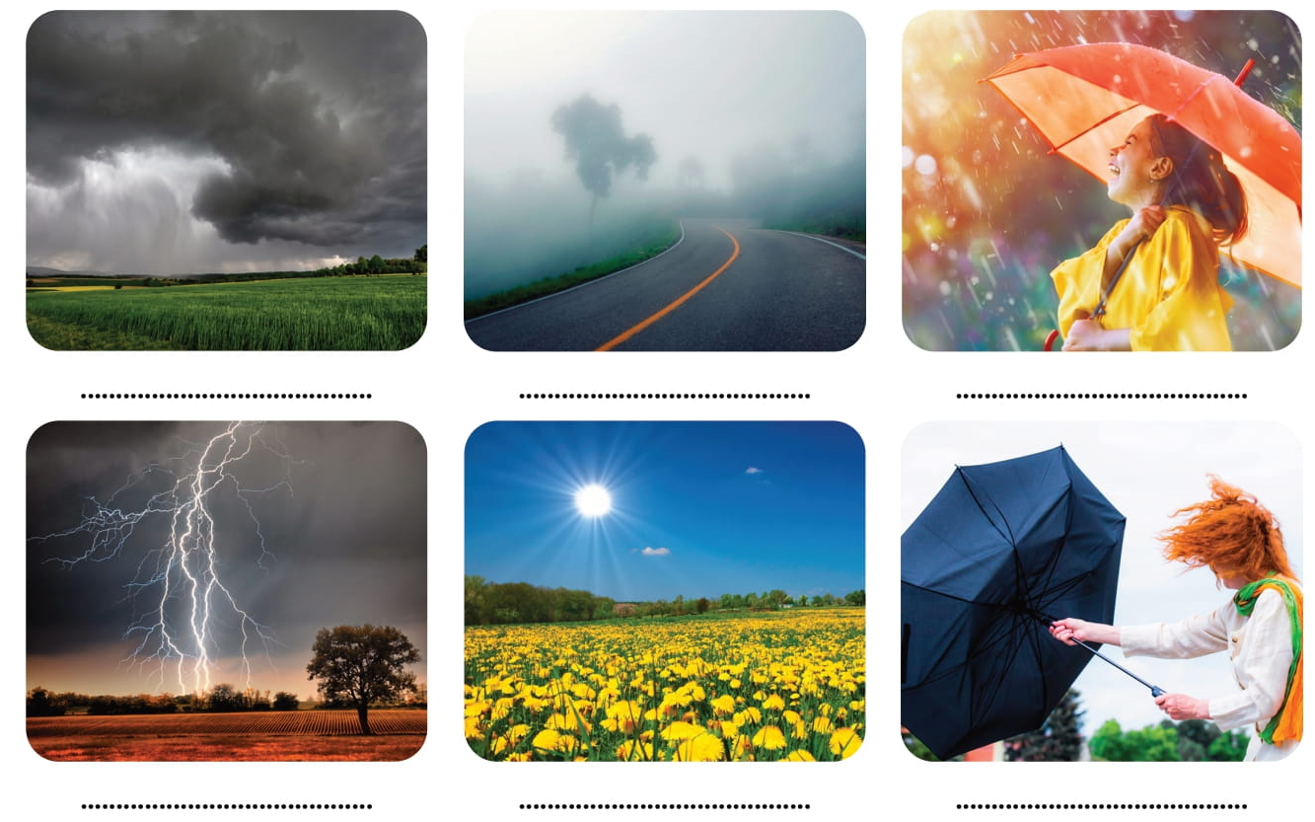

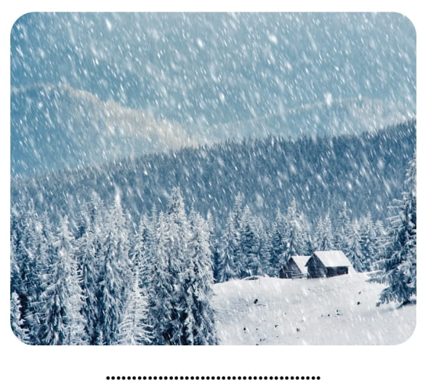
It’s stormy.
It’s foggy.
It’s rainy.
It’s cloudy.
There’s thunder and lightning.
It’s sunny.
It’s windy.
It’s snowy.

Slide 19
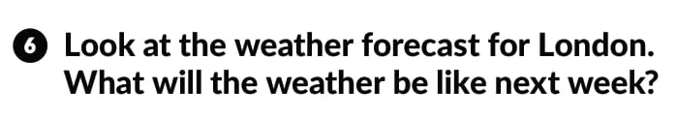
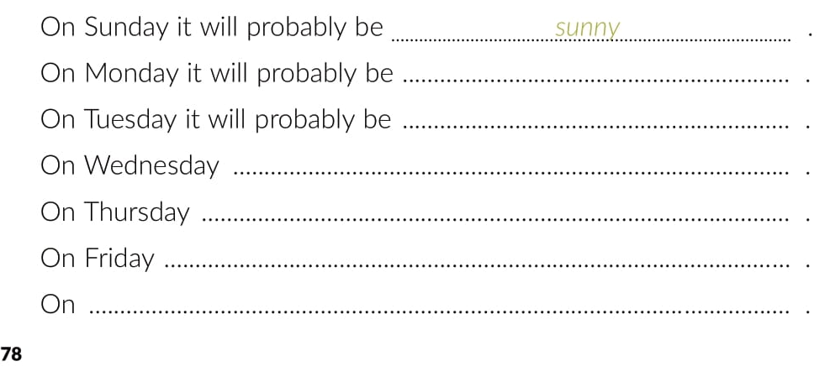
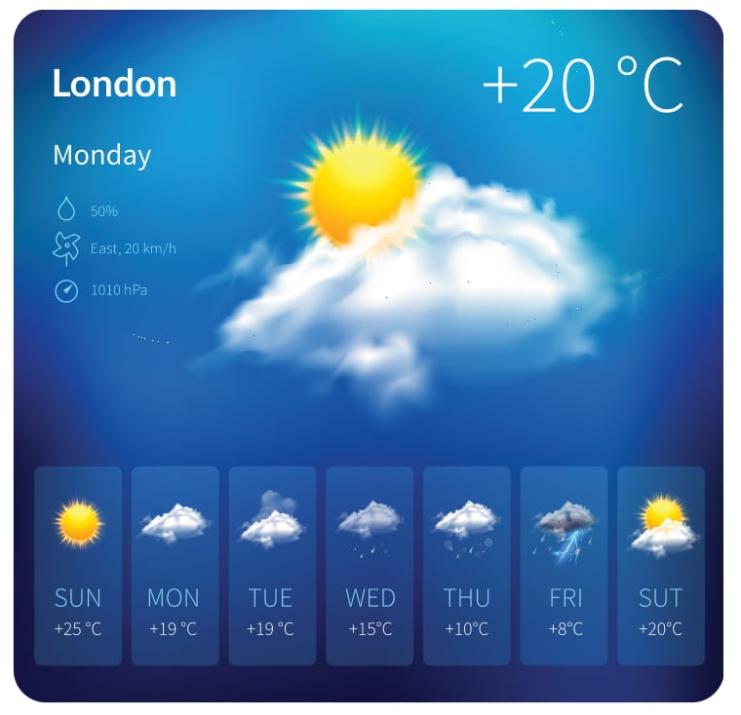

Slide 20

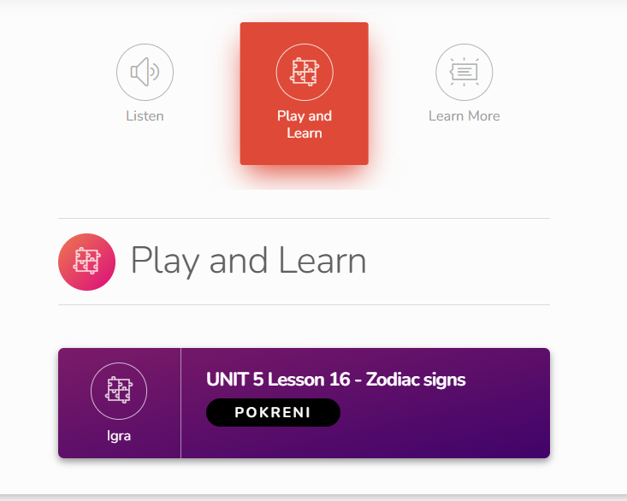
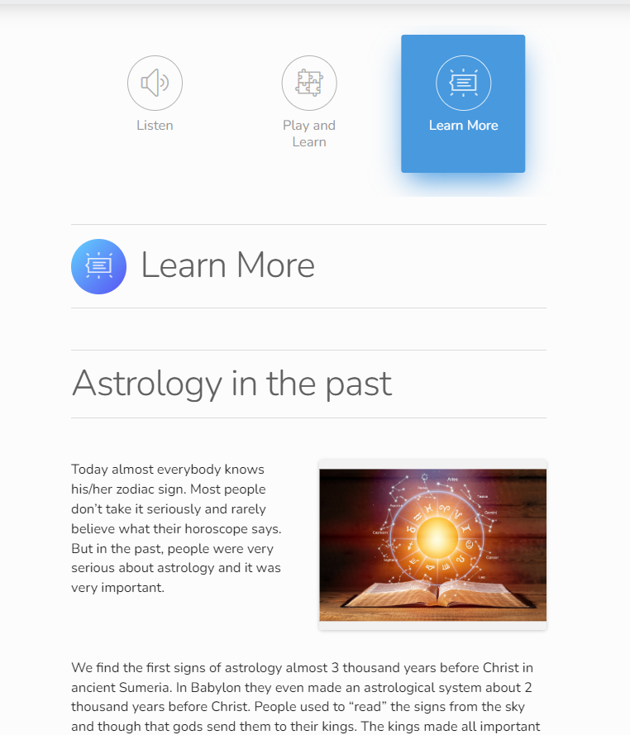
Otvori sljedeću poveznicu
Lesson 16 It's written in the stars | Way to go 3 (e-sfera.hr)

